Slide 1
Belco Walks

Slide 2
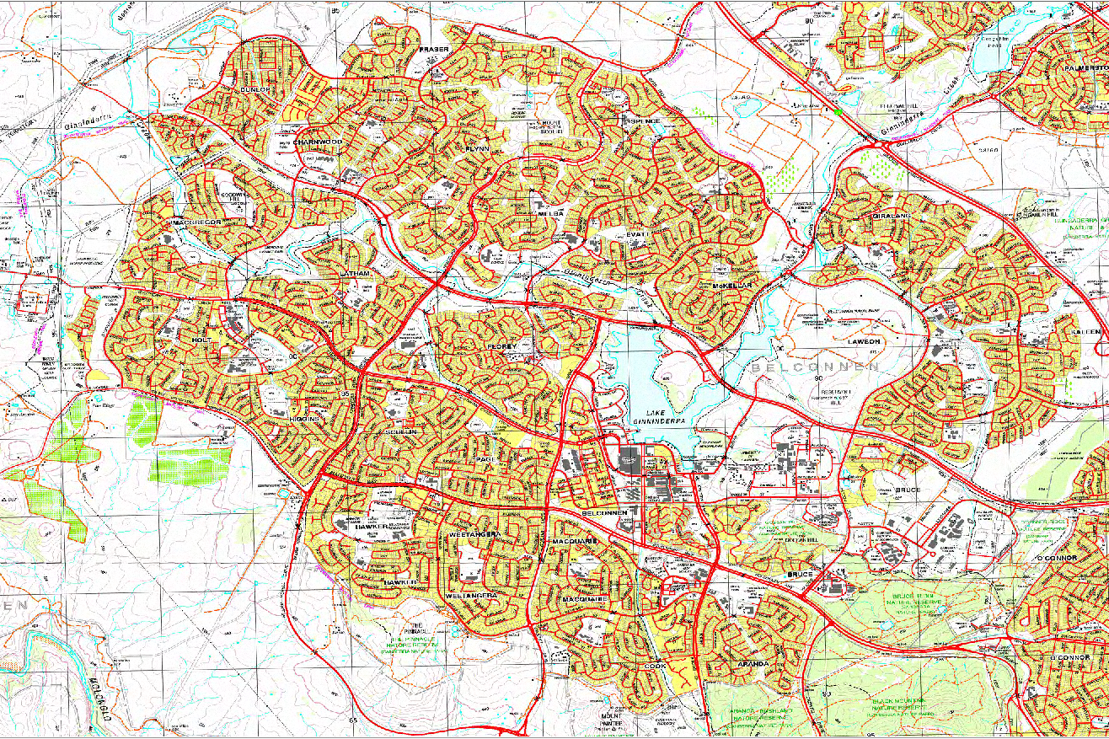

Slide 3
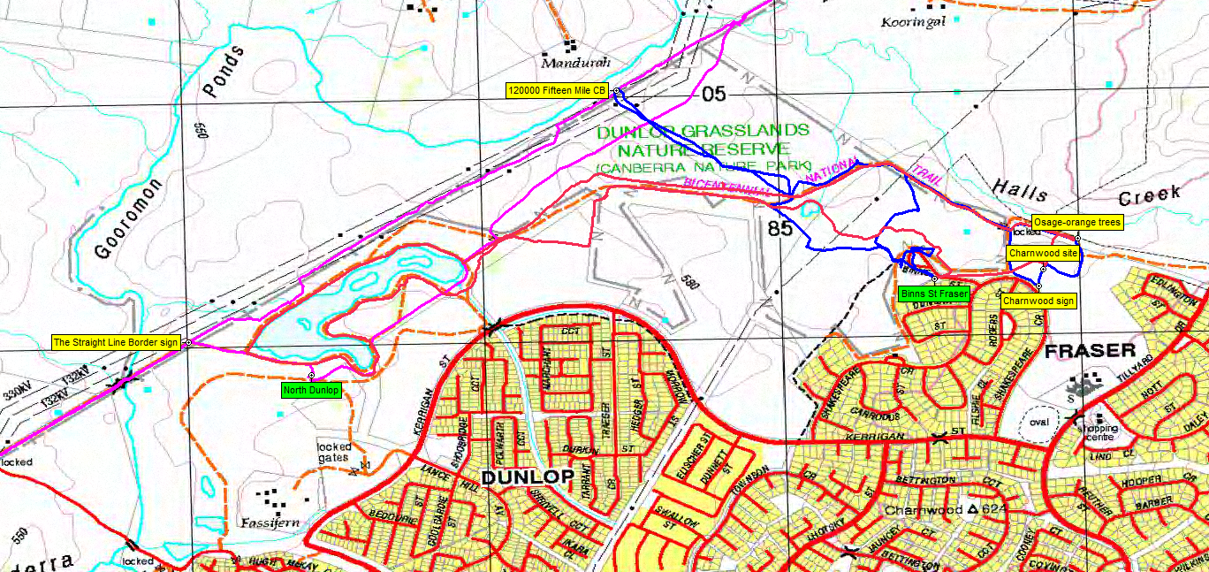
1 Dunlop Grasslands Nature Reserve
• Charnwood homestead site; Crowajingalong
• Osage orange trees
• Canberra Tracks interactive signage
• ACT-NSW border markers
• TAMS map www.tams.act.gov.au/__data/assets/pdf_file/0008/390581/cnpmapdunlop.pdf

Slide 4
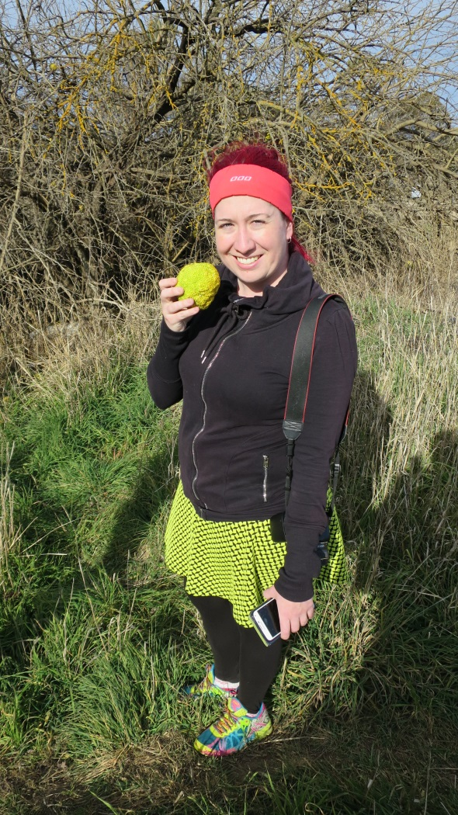
Osage orange with matching skirt

Slide 5
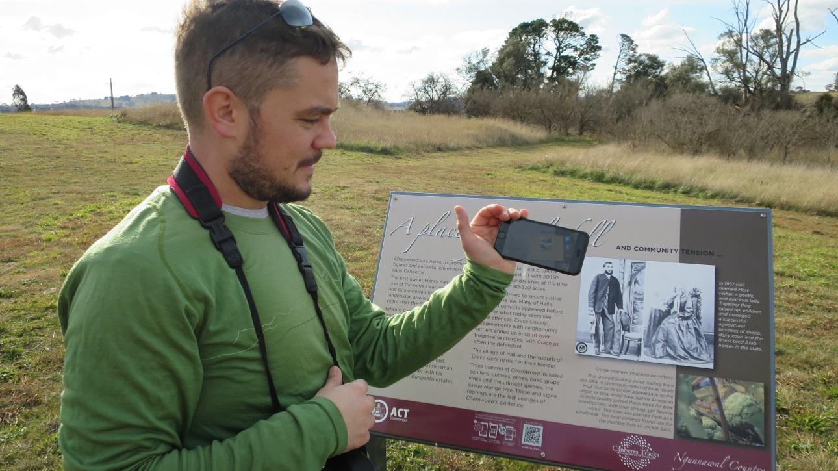
Listening to Henry Hall, Ginninderra’s first resident landholder, via the Canberra Tracks app
Osage orange with matching skirt

Slide 6
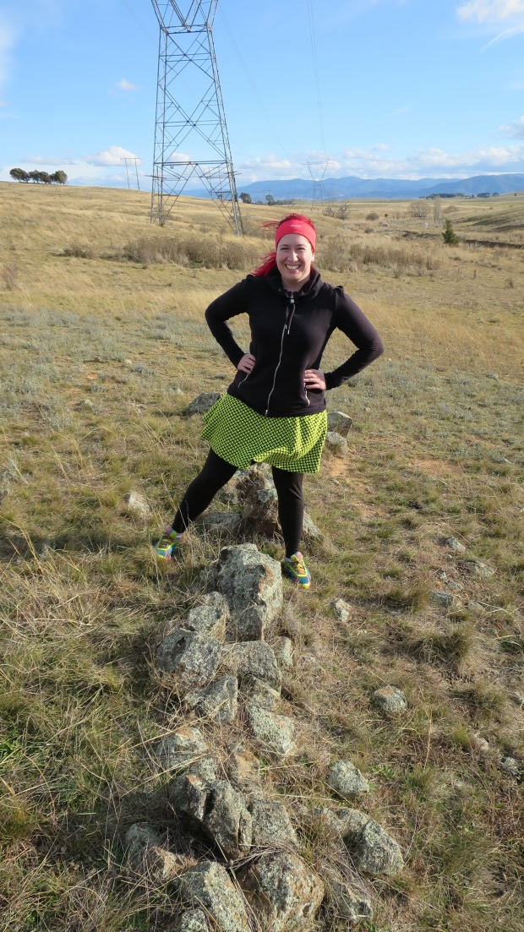
ACT border marker 120000/15 Mile

Slide 7
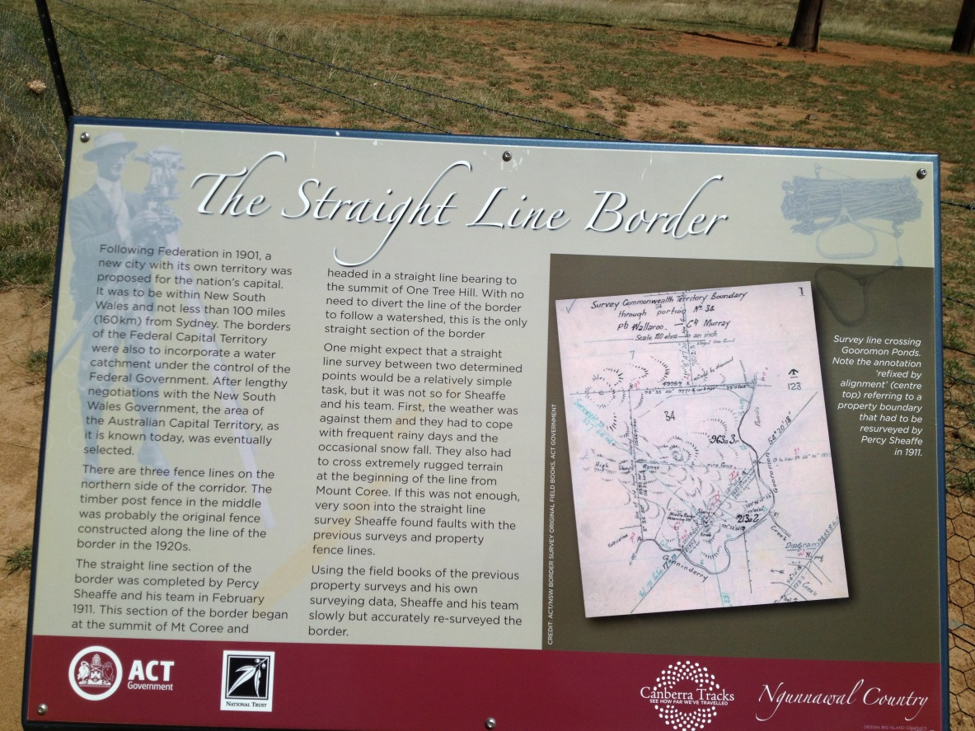
Border signage
ACT border marker 120000/15 Mile

Slide 8
1 Dunlop Grasslands NR
2 Weetangera Methodist cemetery

Slide 9
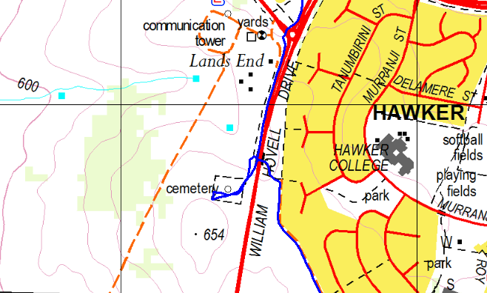
2 Weetangera Methodist cemetery
• on the west side of William Hovell Dr, near the end of Belconnen Way
• old graves (if you’re into those)
• a lovely peaceful place
• park safely. Safest approach via underpass from Hawker

Slide 10
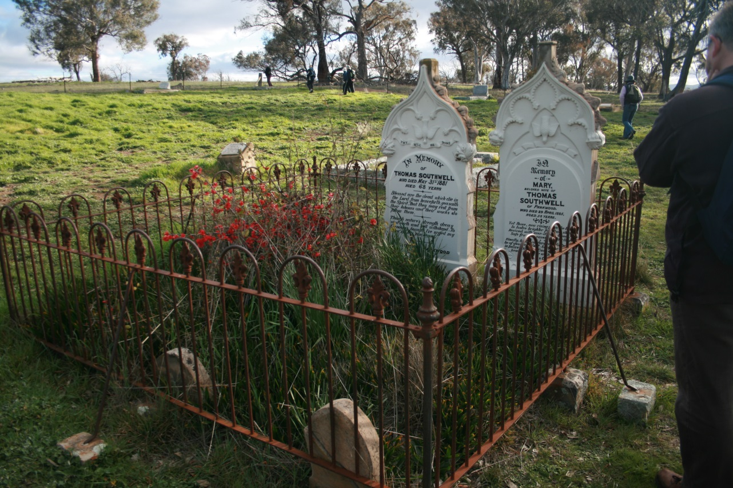
1881 and 1885 graves

Slide 11
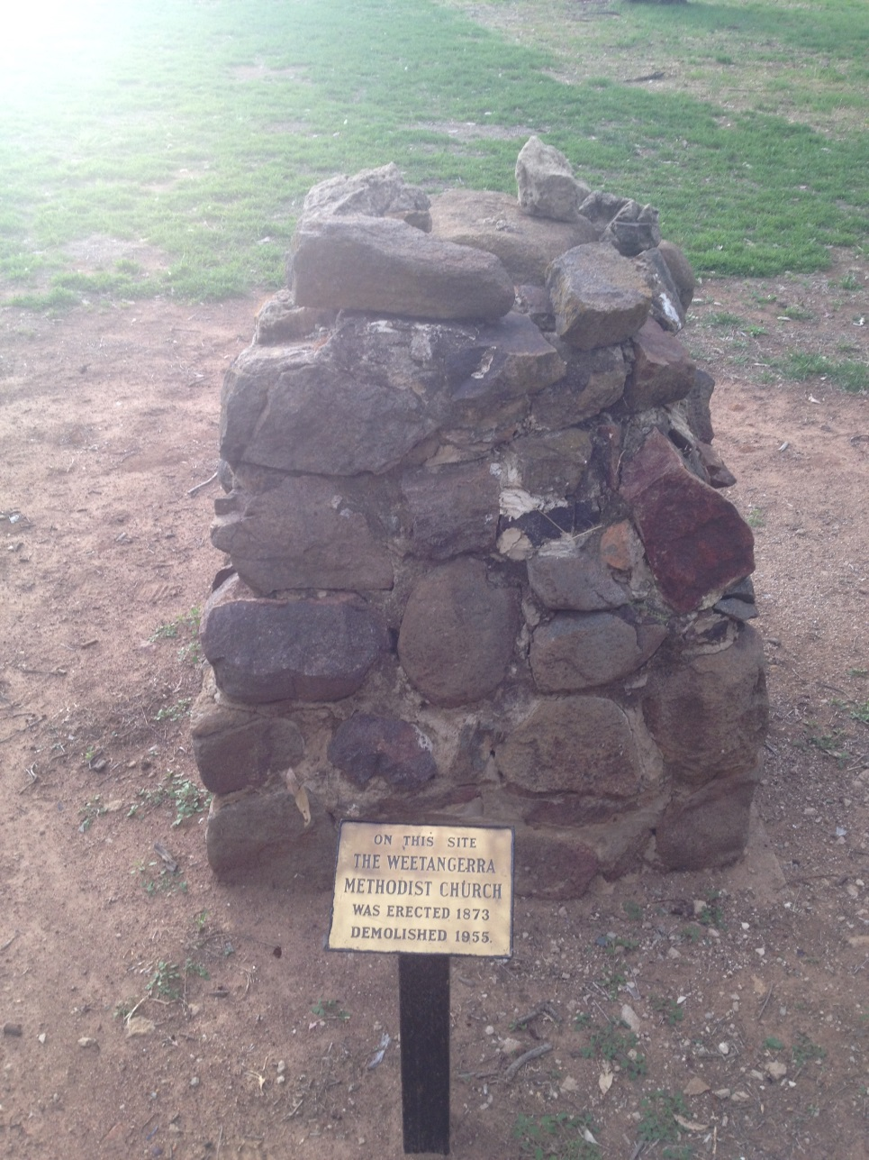
1881 and 1885 graves
Church erected 1873

Slide 12
1 Dunlop Grasslands NR
3 Palmerville Heritage Park
2 Weetangera Methodist cemetery

Slide 13
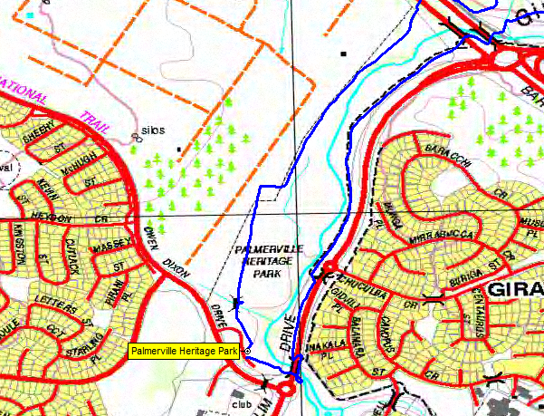
3 Palmerville Heritage Park
• an unofficial village dating from 1826
• gravel path, wheelchair friendly
• National Landcare Forest

Slide 14
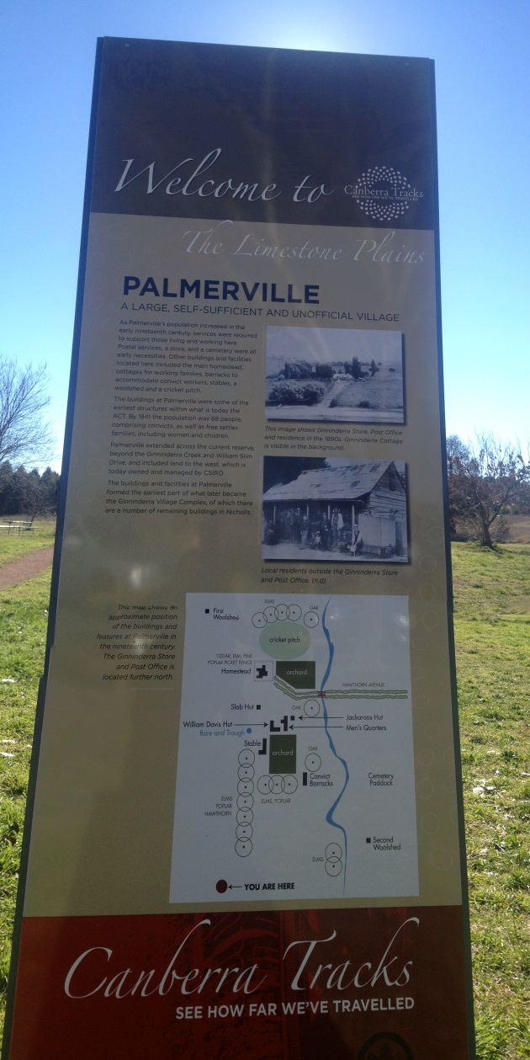
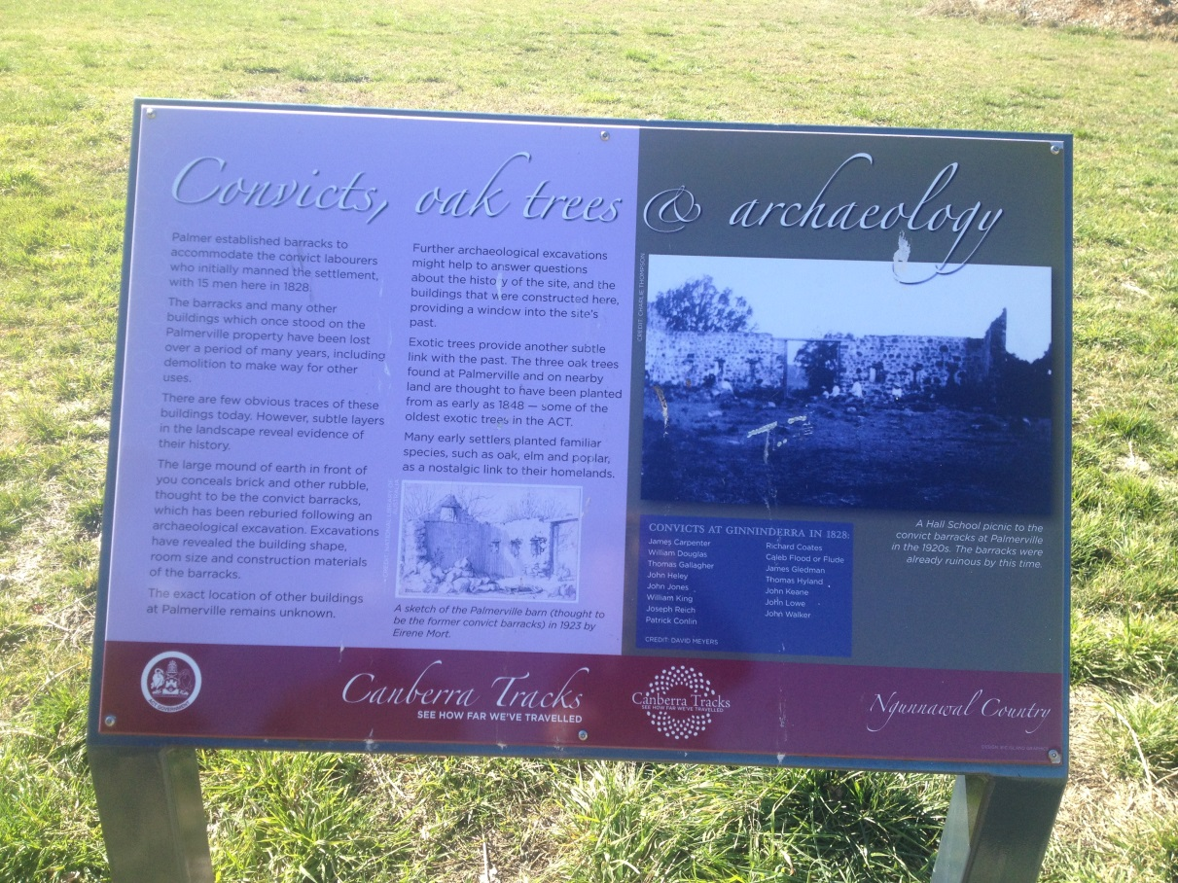
Palmerville signage

Slide 15
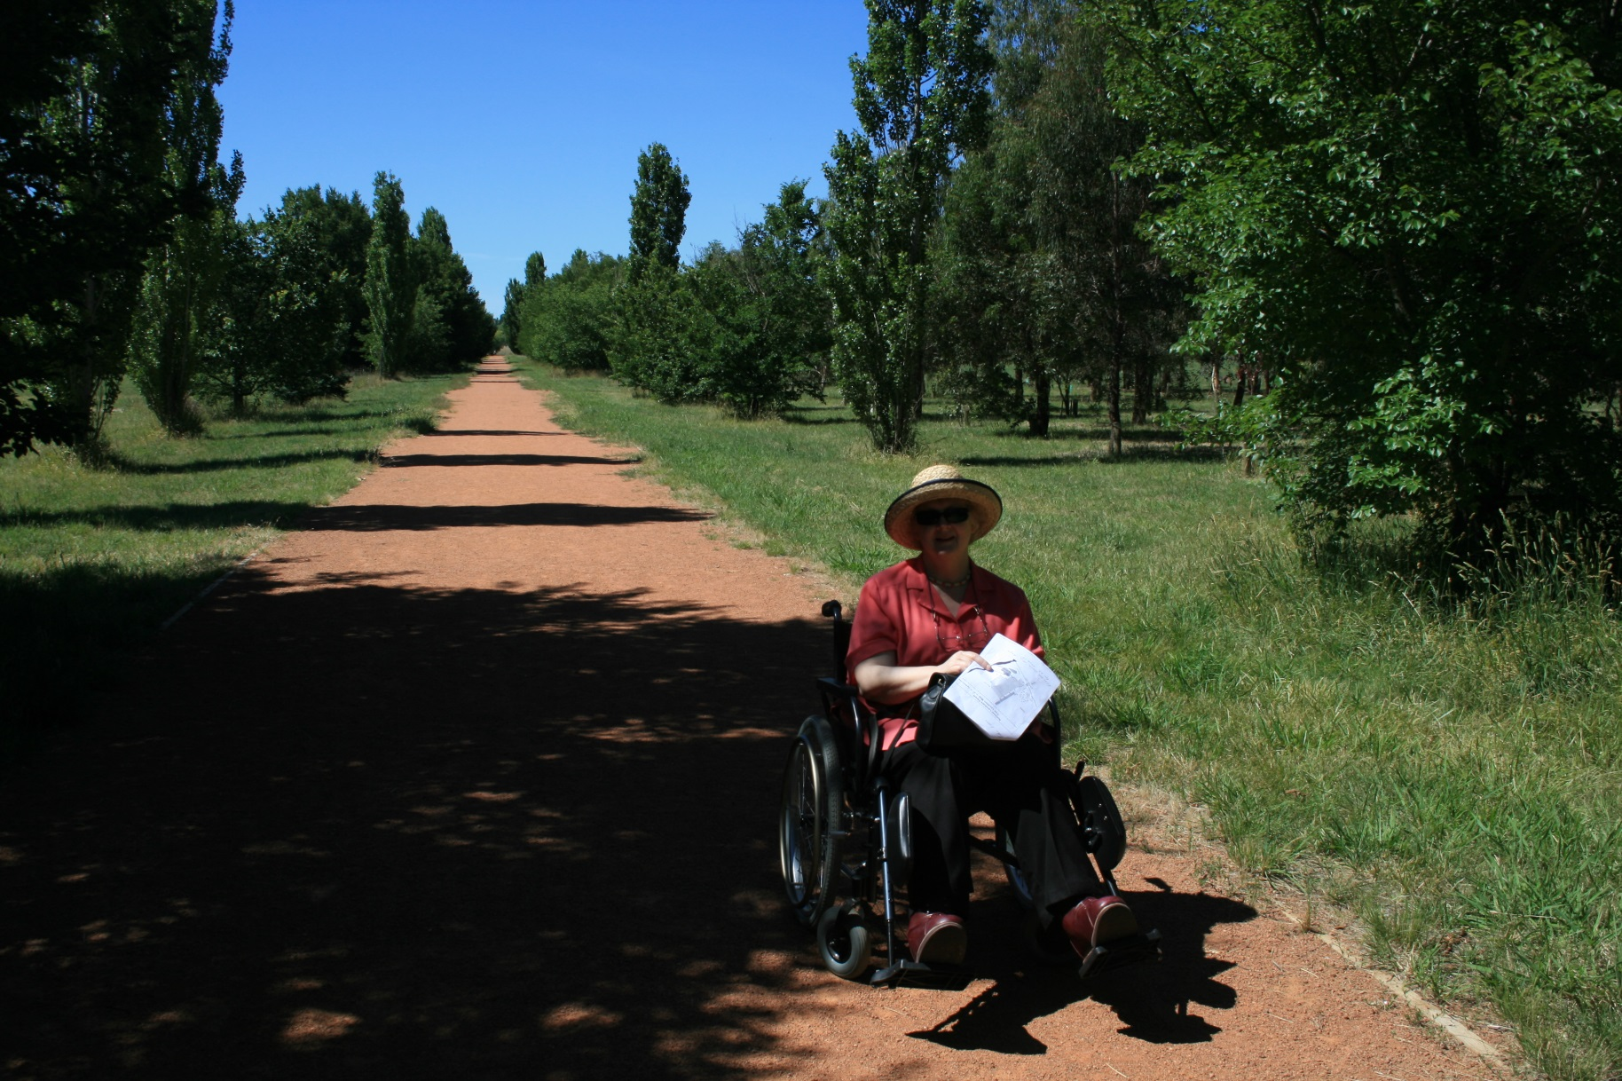
Wheelchair friendly

Slide 16
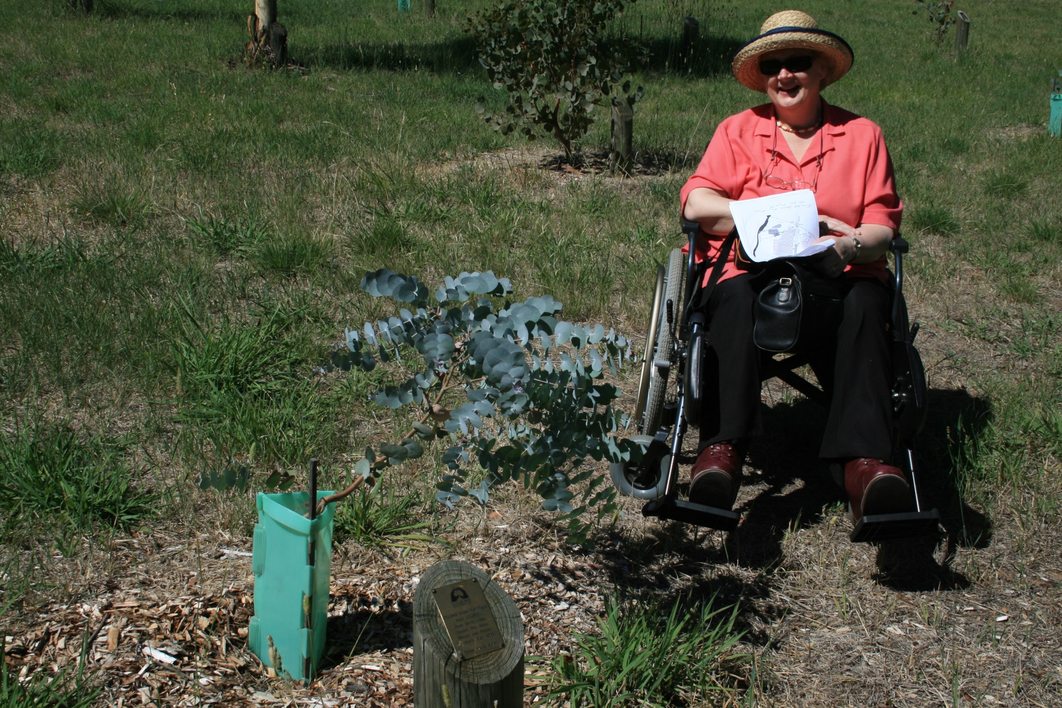
National Landcare Forest

Slide 17
1 Dunlop Grasslands NR
3 Palmerville Heritage Park
4 Lake Ginninderra and the CCT
2 Weetangera Methodist cemetery

Slide 18
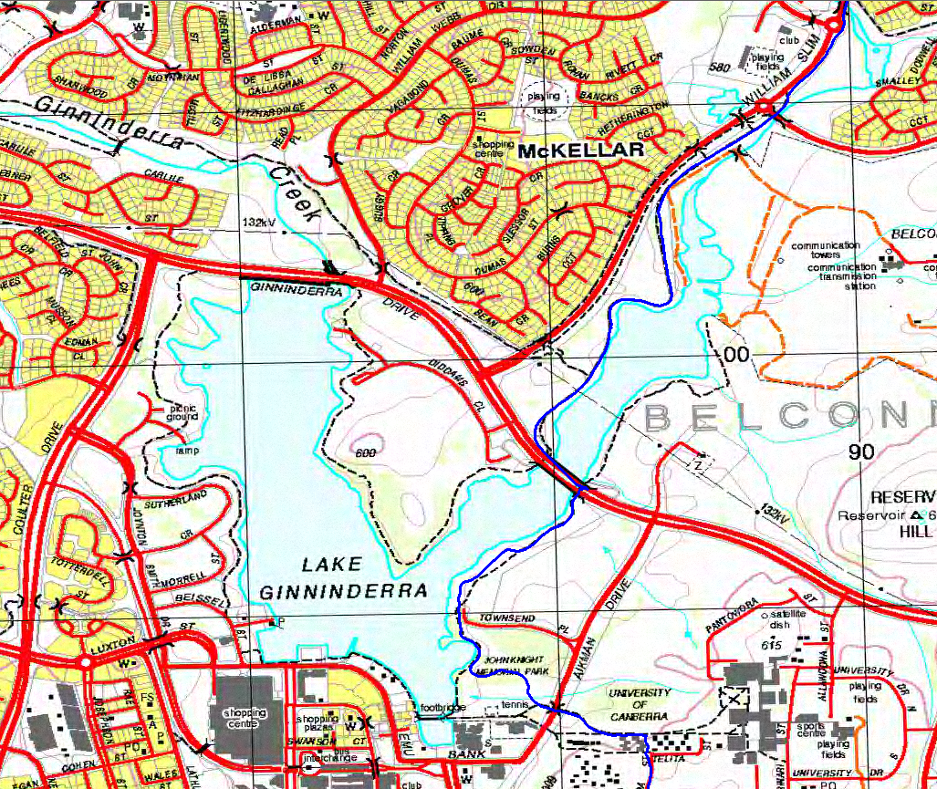
4 Lake Ginninderra and the Canberra Centenary Trail
• many entry points • Emu Bank cafés
• CCT down the east side http://www.tams.act.gov.au/parks-recreation/recreational_activities/canberra_centenary_trail

Slide 19
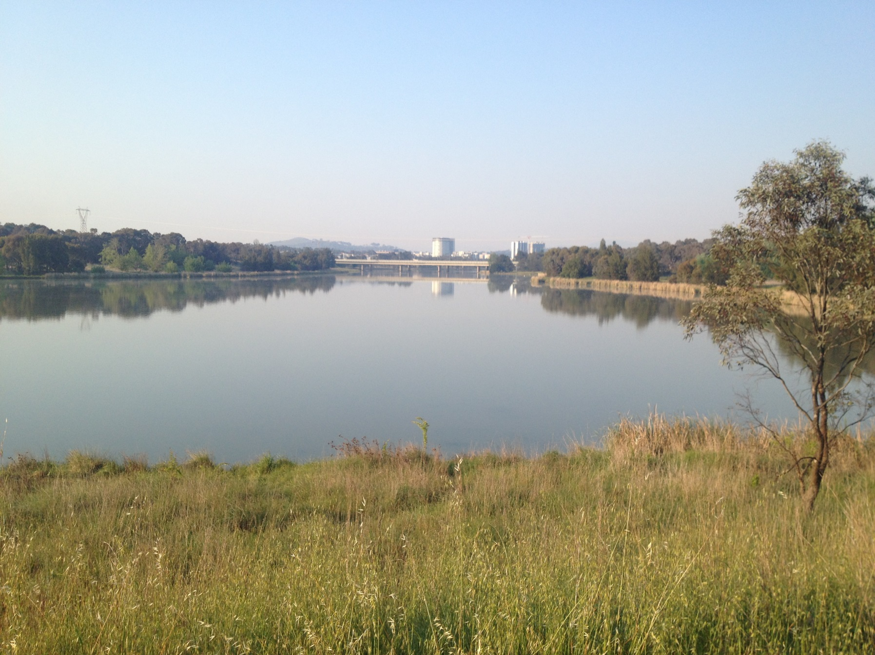
Belconnen from the Ginninderra Creek entrance arm of Lake Ginninderra

Slide 20
1 Dunlop Grasslands NR
3 Palmerville Heritage Park
4 Lake Ginninderra and the CCT
2 Weetangera Methodist cemetery
5 Gossan Hill NR

Slide 21
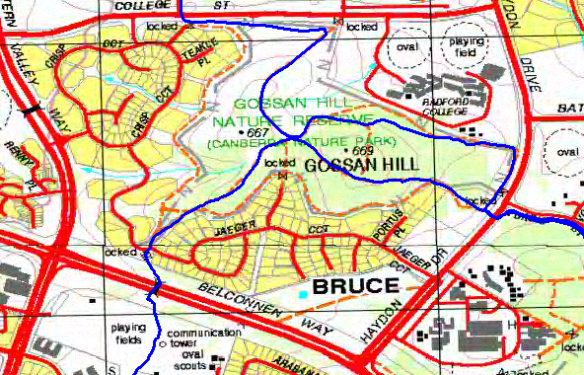
5 Gossan Hill NR
• bounded by College St, Haydon Dr, Belconnen Way, Eastern Valley Way • dog friendly (on leash)
• TAMS map http://www.tams.act.gov.au/__data/assets/pdf_file/0006/390579/cnpmapgossan.pdf

Slide 22
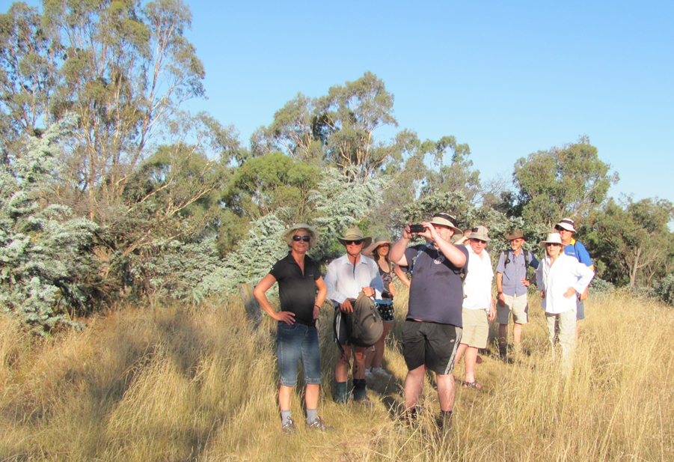
Walkers on Gossan Hill

Slide 23
1 Dunlop Grasslands NR
6 Ginninderra Creek, incl Umbagong District Park and Latham axe-grinding grooves
3 Palmerville Heritage Park
4 Lake Ginninderra and the CCT
2 Weetangera Methodist cemetery
5 Gossan Hill NR

Slide 24
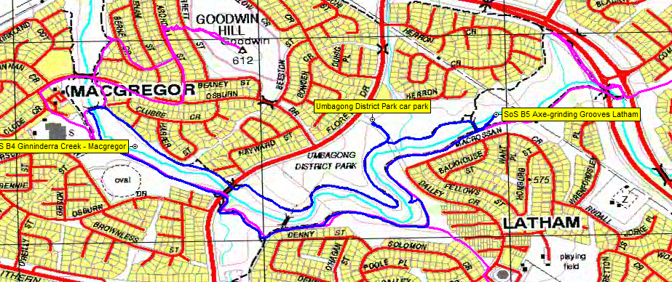
6 Ginninderra Creek, incl Umbagong District Park and Latham axe-grinding grooves
• Umbagong = Ngunnawal ‘axe’ • Sites of Significance in the ACT
• shared paths (‘bike paths) – walk or ride

Slide 25
Umbagong District Park

Slide 26
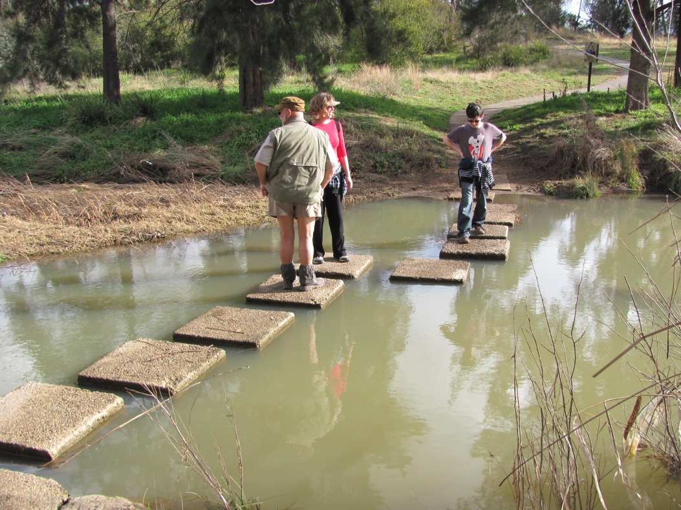
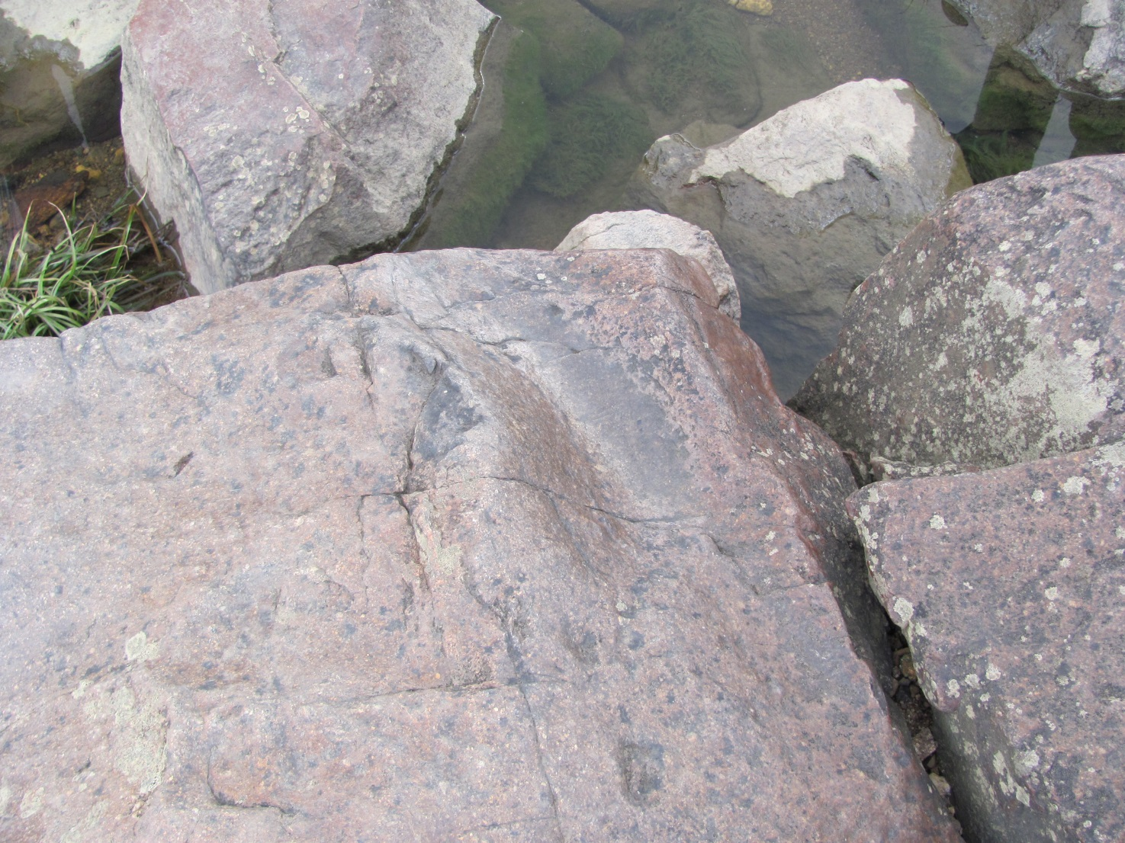

Slide 27
1 Dunlop Grasslands NR
6 Ginninderra Creek, incl Umbagong District Park and Latham axe-grinding grooves
3 Palmerville Heritage Park
4 Lake Ginninderra and the CCT
2 Weetangera Methodist cemetery
5 Gossan Hill NR
7 Kama NR

Slide 28
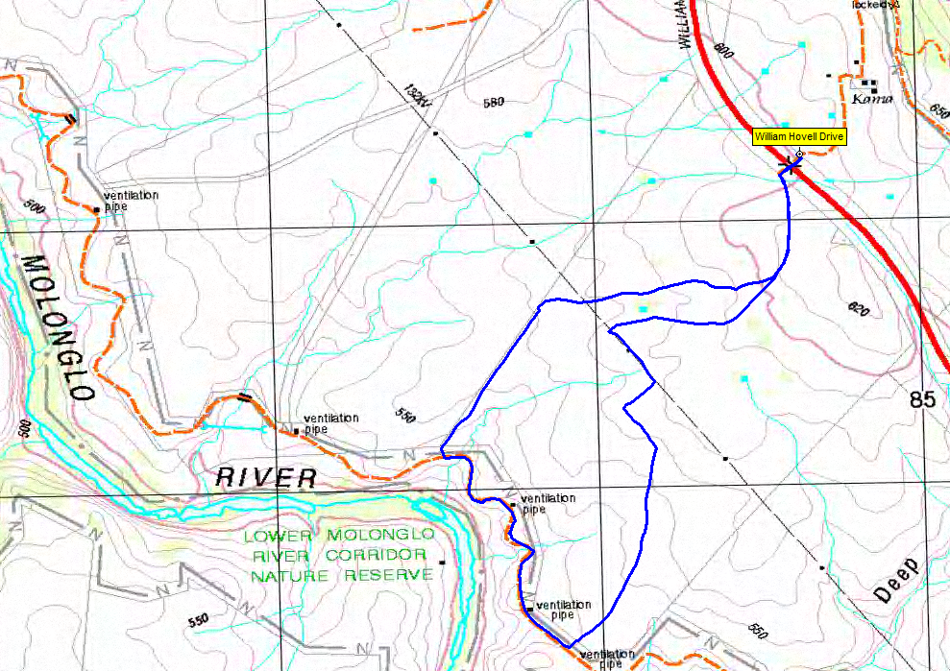
7 Kama NR
• latest edition to the Canberra Nature Park • park on east side of William Hovell Dr and walk through underpass • marked walks – Dam Walk (1.9km return) and River Walk (5.4km return)
• TAMS map http://www.tams.act.gov.au/__data/assets/pdf_file/0008/386108/Kama-Nature-Reserve-Self12.pdf

Slide 30
1 Dunlop Grasslands NR
6 Ginninderra Creek, incl Umbagong District Park and Latham axe-grinding grooves
3 Palmerville Heritage Park
4 Lake Ginninderra and the CCT
8 Shepherds Lookout and Woodstock NR
2 Weetangera Methodist cemetery
5 Gossan Hill NR
7 Kama NR

Slide 31
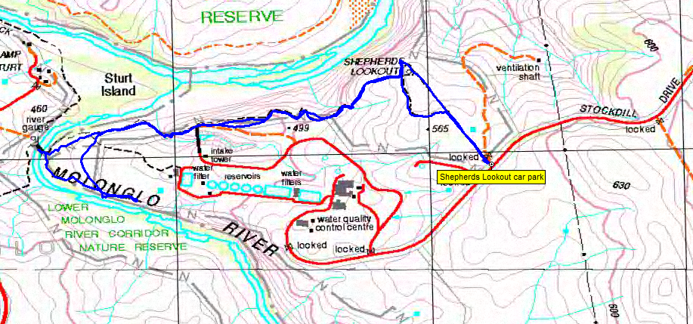
8 Shepherds Lookout and Woodstock NR
• down the end of Stockdill Dr near the water quality control centre • views over the Murrumbidgee River • some dog-friendly areas

Slide 33
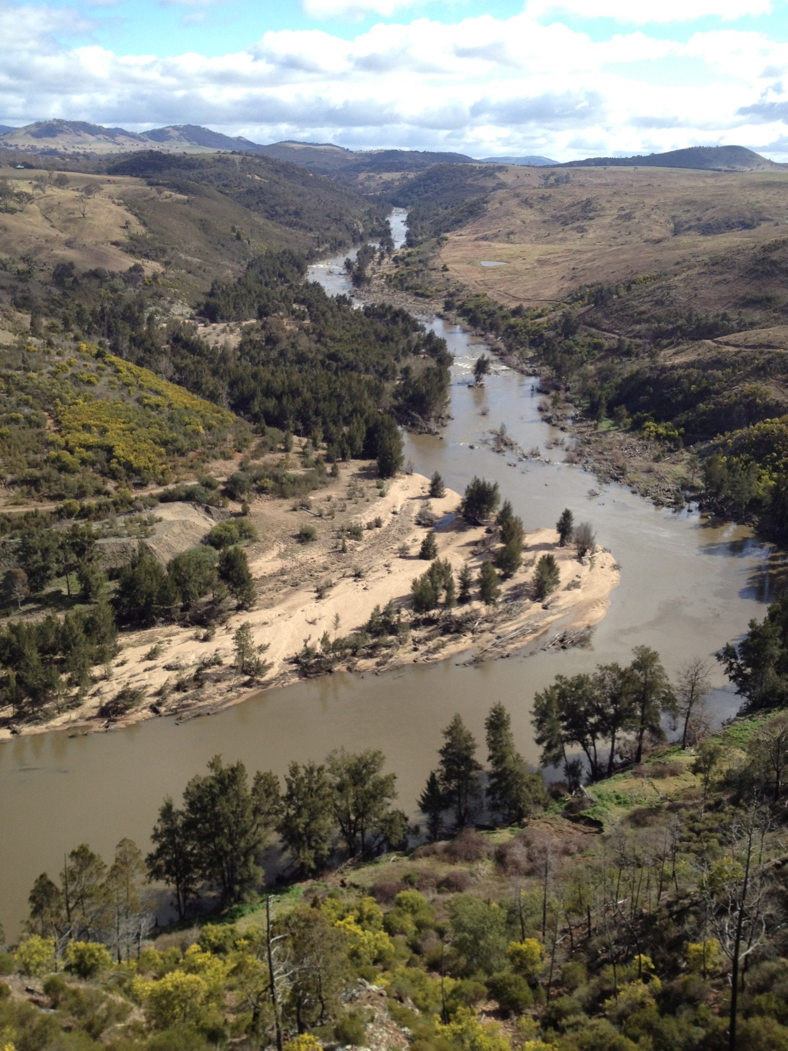

Slide 34
1 Dunlop Grasslands NR
6 Ginninderra Creek, incl Umbagong District Park and Latham axe-grinding grooves
3 Palmerville Heritage Park
4 Lake Ginninderra and the CCT
8 Shepherds Lookout and Woodstock NR
2 Weetangera Methodist cemetery
5 Gossan Hill NR
7 Kama NR
9 The Pinnacle and Mt Painter

Slide 35
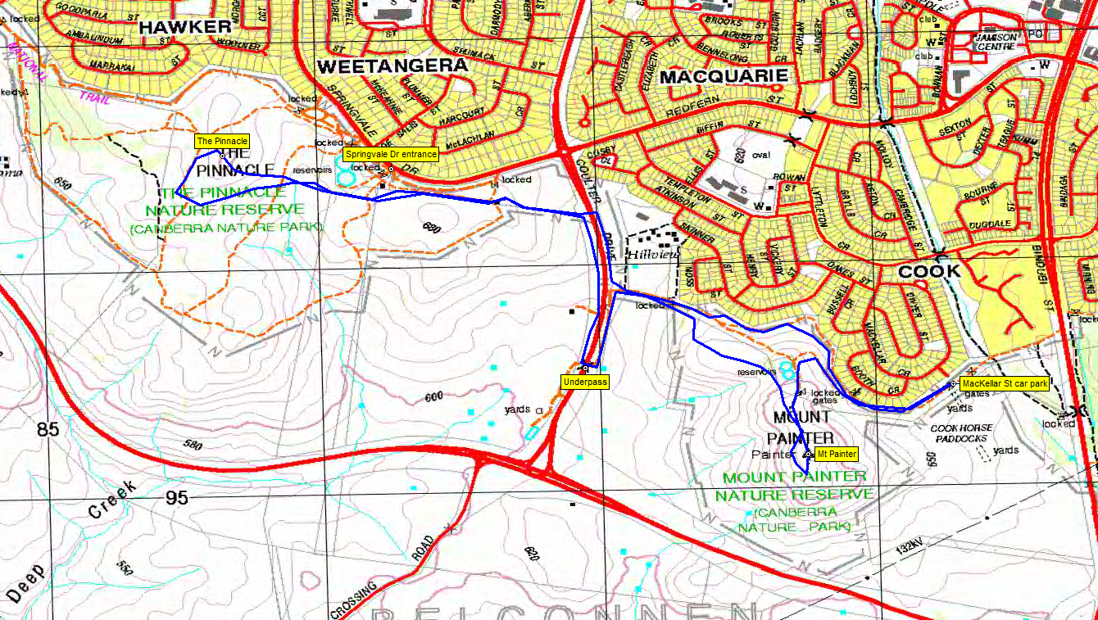
9 The Pinnacle and Mt Painter
• bounded by Belco southern suburbs, William Hovell Dr and Bindubi St • some of the best urban views from Mt Painter • land care groups • TAMS maps http://www.tams.act.gov.au/__data/assets/pdf_file/0008/390698/Pinnacle_brochure.pdf and http://www.tams.act.gov.au/__data/assets/pdf_file/0005/390605/MTPAINTER.pdf

Slide 36
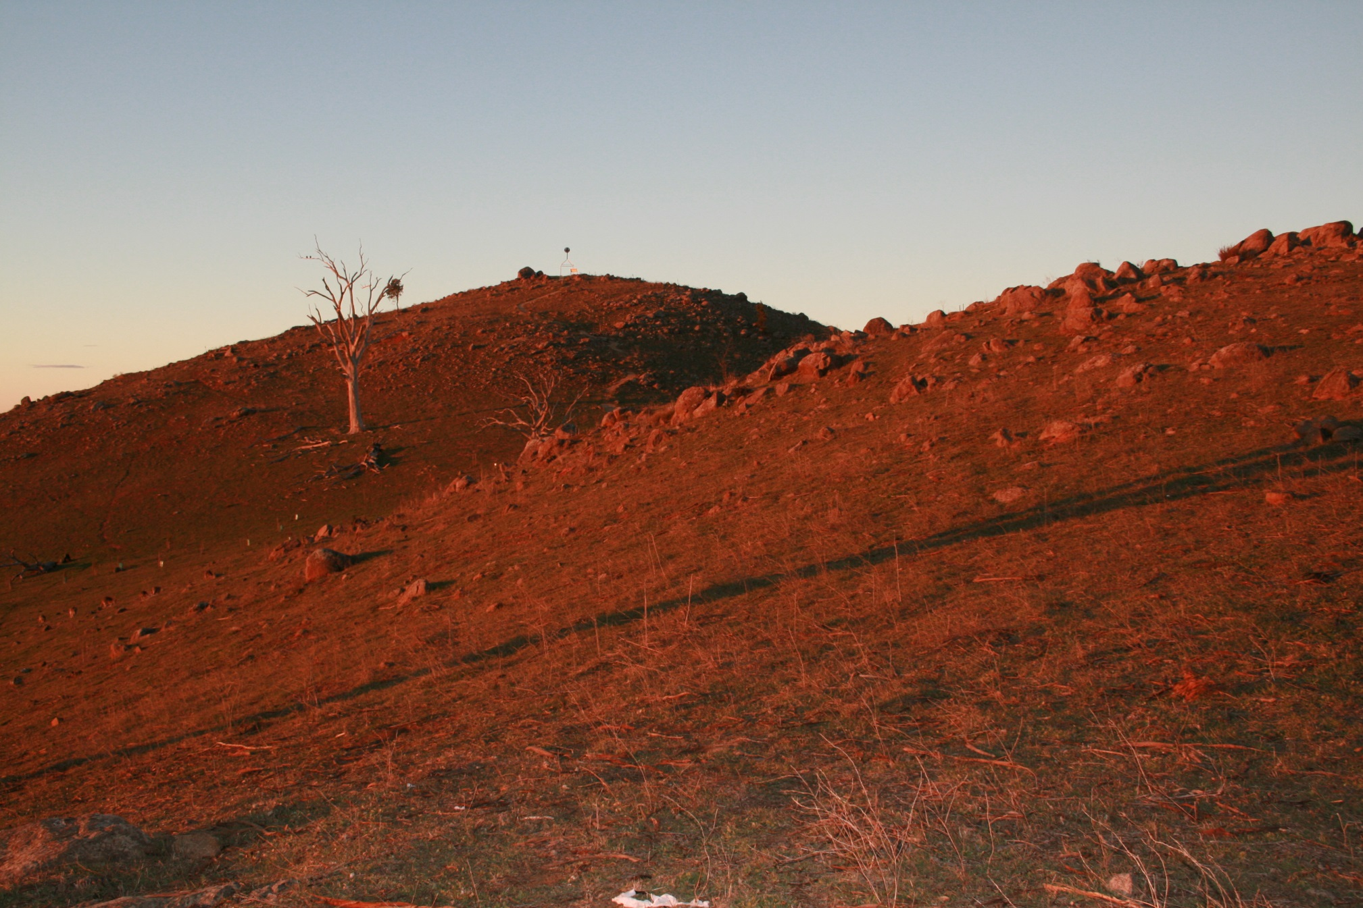
Mt Painter

Slide 37
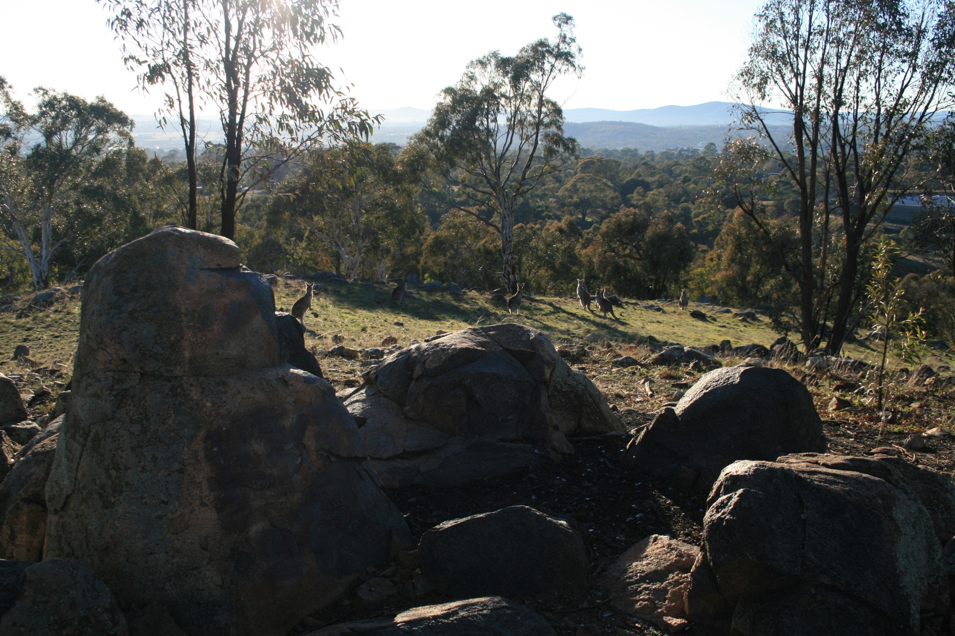
The Pinnacle

Slide 38
Others
Goodwin Hill
Mt Rogers Reserve
Aranda Bushland NR
Molonglo River Corridor
_____________________
Bike riding on the bike path network
Geocaching

Slide 39
Canberra Bushwalking Club
www.canberrabushwalkingclub.org
Johnny Boys Walkabout Blog
www.johnevans.id.au
You’ll find tonight’s presentation there

